Slide 1
Digital Twin
A digital twin is a digital replica of a living or non-living physical entity. Digital twin refers to a digital replica of potential and actual physical assets, processes, people, places, systems and devices that can be used for various purposes.

Slide 2
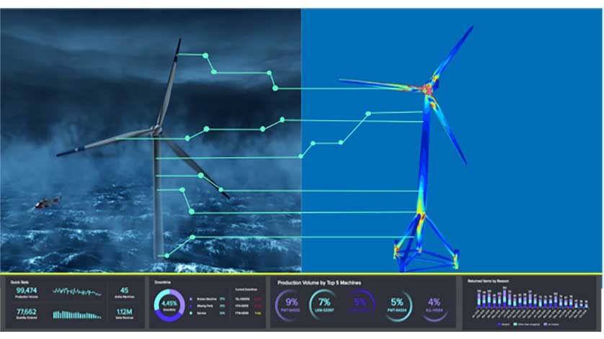

Slide 3
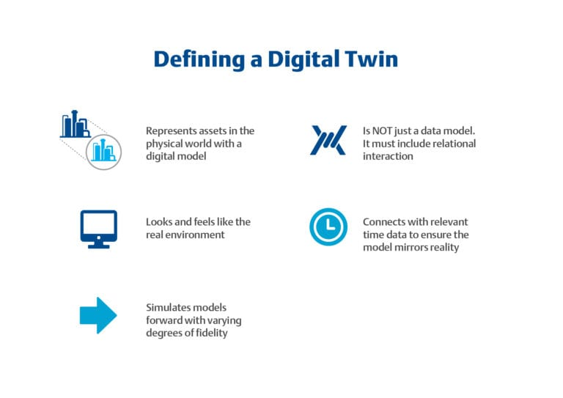

Slide 4
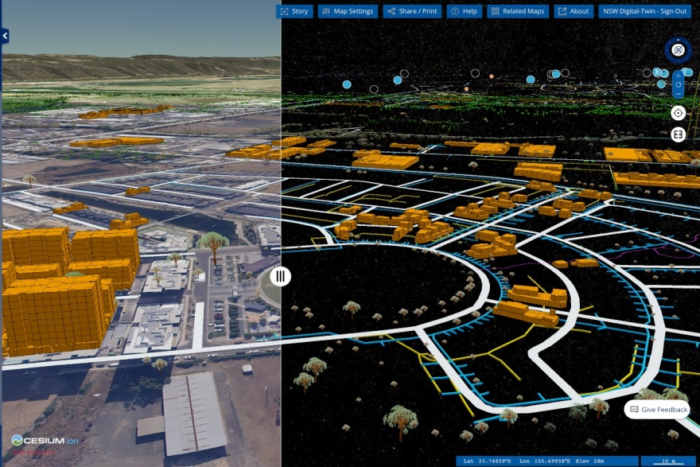

Slide 5
Microgrid
Microgrid is a group of interconnected loads and distributed energy resources within clearly defined electrical boundaries that acts as a single controllable entity with respect to the grid. A microgrid can

Slide 6
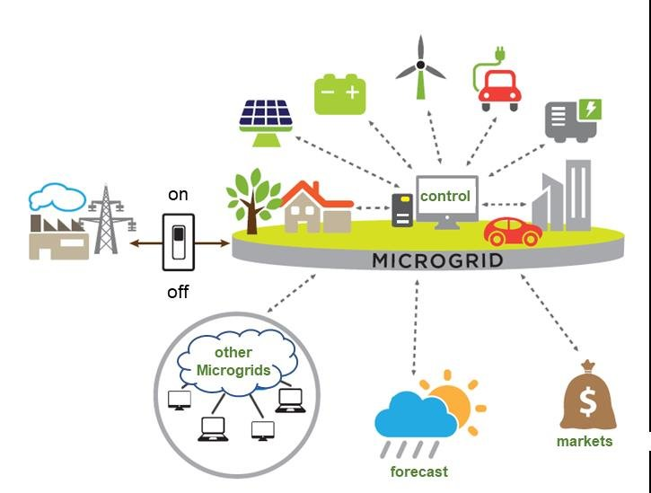

Slide 7
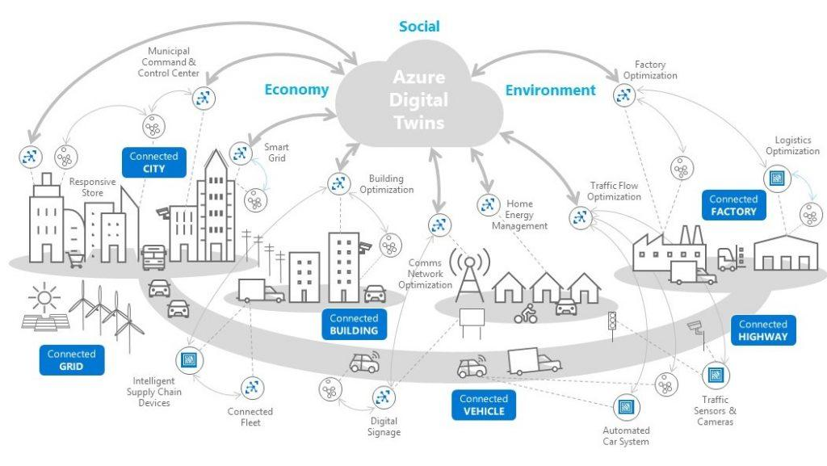

Slide 8
Digital Twin Micrigrid
The digital twin microgrid is an approach to combine 2 different technologies to make a better and efficient system that will be more secure and will not only be able to monitor the actual behavior but also can control the physical grid system.

Slide 9
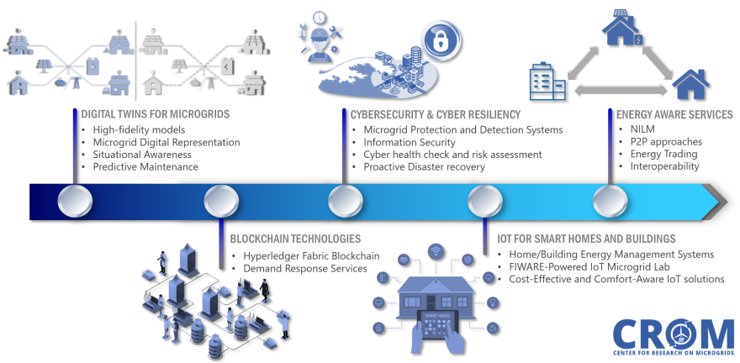

Slide 10
References
“Creating Digital Twins for Smart Cities - the Race Is On.” OpenLM Blog, 17 Jan. 2019, openlm.com/blog/creating-digital-twins-for-smart-cities-the-race-is-on/.
Bailey, Mary Page. “Understanding the Digital Twin.” Chemical Engineering, 27 Feb. 2019, www.chemengonline.com/understanding-the-digital-twin.
Posted by Ocean News. “Ocean News.” ONT, 31 Oct. 2018, www.oceannews.com/news/energy/innogy-and-shell-back-predictive-digital-twin-pioneer-with-10-million-investment.
“New South Wales Government Launches Digital Twin.” Smart Cities World, 25 Feb. 2020, www.smartcitiesworld.net/news/news/new-south-wales-government-launches-digital-twin-5060.

